Slide 1
Supporting Mobile Interaction Using smartphone barometer sensing
By Andrew Miner
Notes:
NOTE:
To change the image on this slide, select the picture and delete it. Then click the Pictures icon in the placeholder to insert your own image.

Slide 2
Introduction: Smartphone Sensors and Barometer Potential
Smartphones: Everyday Essentials
90% of Americans own a smartphone (Pew Research, 2023).
Modern smartphones contain 10+ micro-electromechanical sensors for motion, position, and environmental data.
These sensors are rarely exploited to their full potential.
There are likely many novel ways to take advantage of these sensors.
Thesis Focus: The Barometer Sensor
The barometer is a relatively simple sensor that detects the local atmospheric pressure. This data is most commonly used to detect elevation.
Barometers are lightweight, don’t require much energy, and are much less invasive than other sensors.
Barometers have an unexpectedly wide range of unconventional applications.
This thesis explores unconventional use cases of a smartphone barometer sensor, specifically focusing on its potential as a user input device.

Slide 3
Related Work
Tongue Gesture Sensing [Maag, et al. ICPADS 2017]
Real-Time Fall Detection [Chen, et al. ICIEA 2012]
In Ground Effect Terrain Detection [Nakanishi, et al. IEEE ISSSRR 2011]
Human Activity Recognition [Xie, et al. INTERTIAL 2018]
Monitoring Building Door Events [Wu, et al. UbiComp 2018]
On-Screen Pressure Assisted Authentication [Yao, et al. IEEE IoT Journal 10 2022]
Location Finding [Hyuga, et al. MELT 2015] [Ye, et al. WCMC 2016] [Ho, et al. MobiCom 2018] [Ye, et al. IEEE Access 7 2019] [Ghoreishi, et al. BioCAS 2023] [Che et al. IEEE Sensor Letters 2024]

Slide 4
Experimentation with Barometer Sensor

Slide 5
Sound Pressure Experiment
Hypothesis
A smartphone’s built-in barometer sensor is sensitive enough to detect a sound source’s distance from the device.
Procedure
Place the smartphone 12 inches away from a Bluetooth speaker.
Play a 1 kHz tone through the speaker.
Record 30 seconds of pressure data.
Repeat this process at distances of 9 inches, 6 inches, 3 inches, and 0~1 inch.

Slide 6
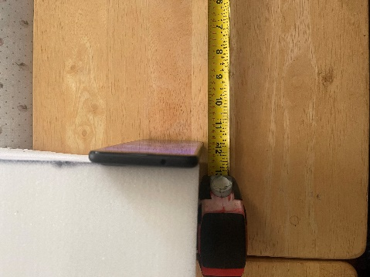
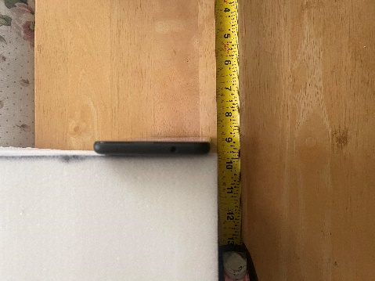
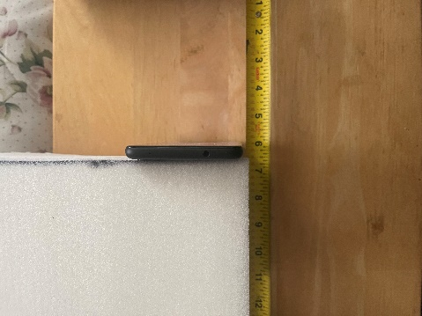
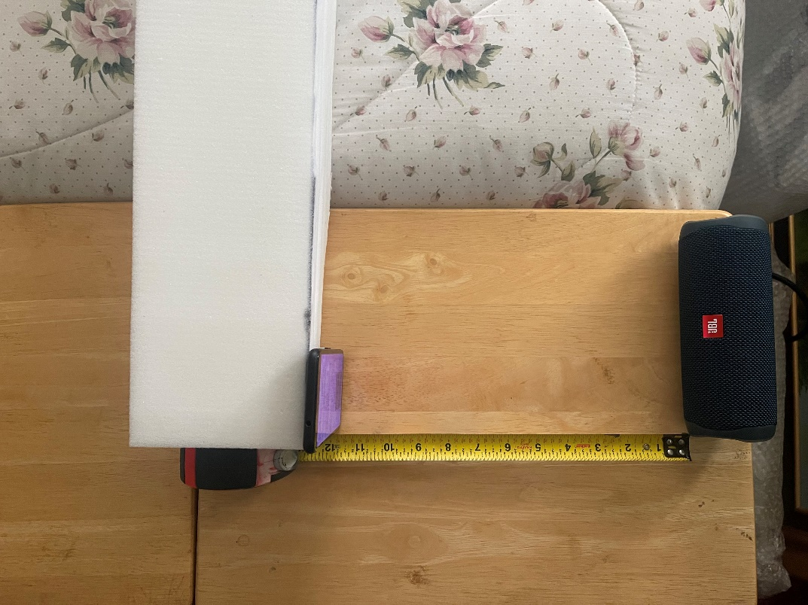
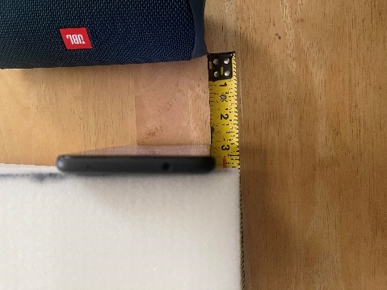
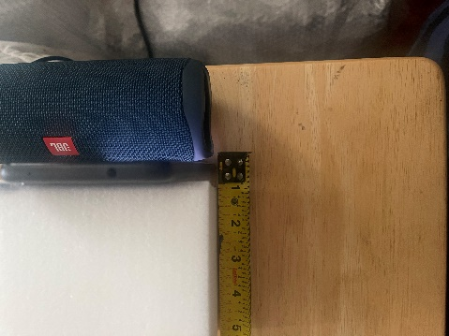
Sound Pressure Experiment – Experimental Setup
Setup
12 Inches
9 Inches
6 Inches
3 Inches
0~1 Inch

Slide 7
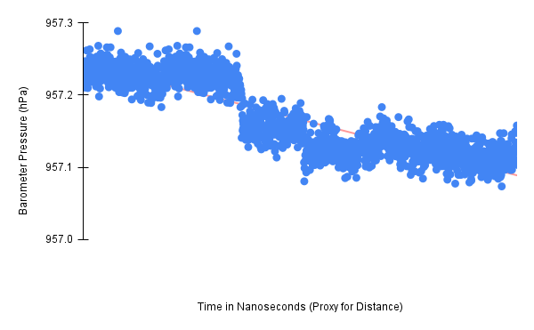
Sound Pressure Experiment – Trail 1 Results

Slide 8
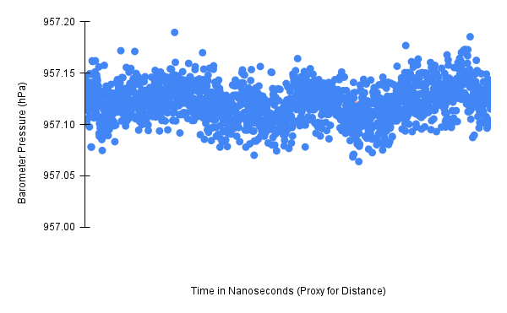
Sound Pressure Experiment – Trail 2 Results

Slide 9
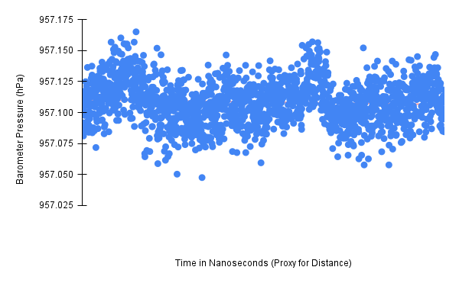
Sound Pressure Experiment – Trail 3 Results

Slide 10
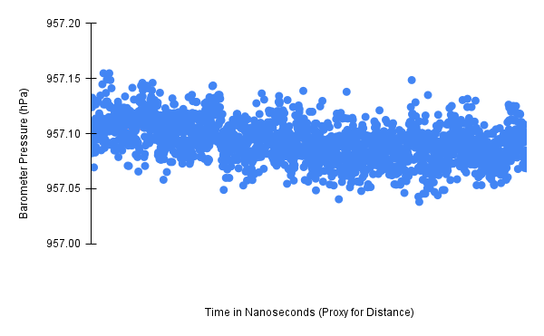
Sound Pressure Experiment – Trail 4 Results

Slide 11
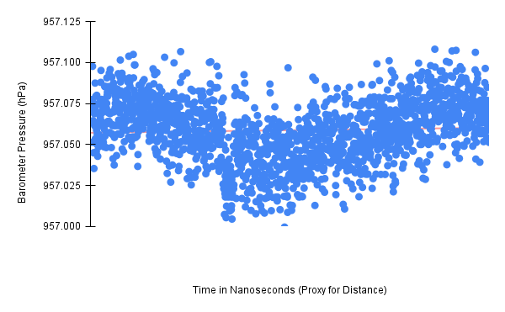
Sound Pressure Experiment – Trail 5 Results

Slide 12
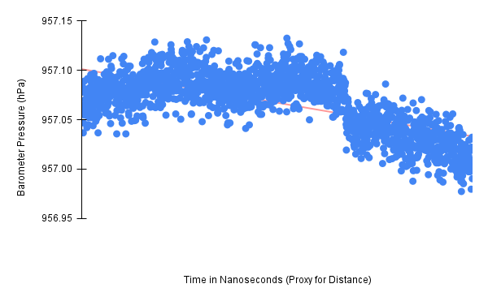
Sound Pressure Experiment – Trail 6 Results

Slide 13
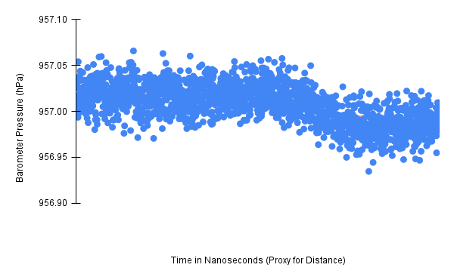
Sound Pressure Experiment – Trail 7 Results

Slide 14
Sound Pressure Experiment – Takeaways
Takeaways
Trials 1, 4, 6, and 7 trend downward toward lower pressure values.
The values measured in Trials 2 and 3 don’t deviate much as the distances change.
Trail 5 trends down until approximately halfway through the trial, then it begins trending up.
Inconsistent results across all seven trials.

Slide 15
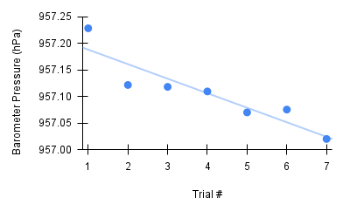
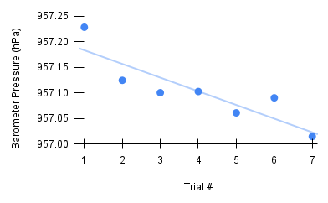
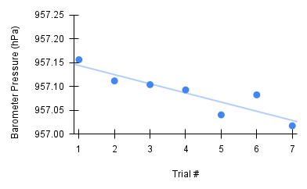
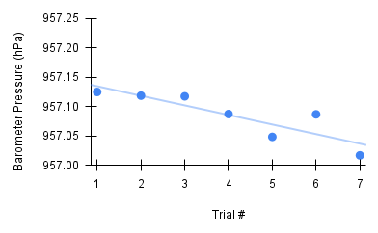
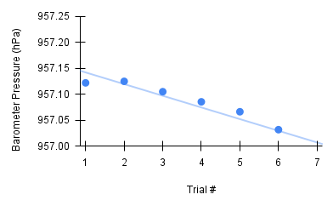
Sound Pressure Experiment – Unexpected Trend Across Trials
12 Inches
9 Inches
6 Inches
3 Inches
0~1 Inch

Slide 16
Ambient Pressure Experiment
The results of the Sound Pressure Experiment suggest that temperature and weather have a strong influence on the ambient pressure, even within an interior room closed off to the outside.
Hypothesis
The ambient pressure measured within an interior room closed off to the outside will fluctuate according to the temperature and weather changes occurring outside.
Procedure
Place a smartphone in a closed-off room with no windows and record pressure data over varying periods of time.

Slide 17
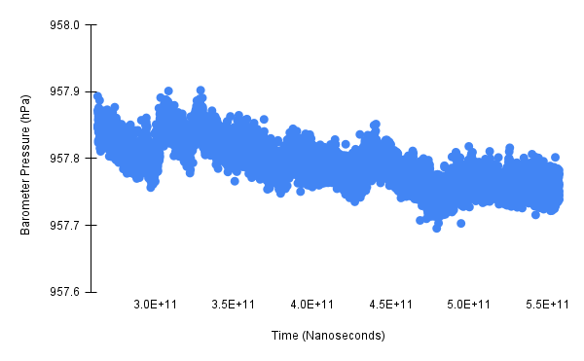
Ambient Pressure Experiment – Trial 1
Trial 1 Information:
Interval: 5 minutes
Time: 12:30 pm - 12:35 pm

Slide 18
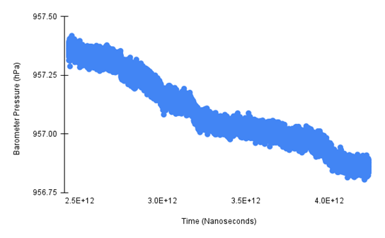
Ambient Pressure Experiment – Trial 2
Trial 2 Information:
Interval: 30 minutes
Time: 1:00 pm - 1:30 pm

Slide 19
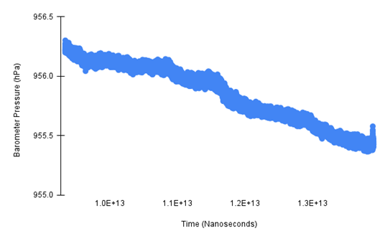
Ambient Pressure Experiment – Trial 3
Trial 3 Information:
Interval: 1 hour 15 minutes
Time: 2:30 pm - 3:45 pm

Slide 20
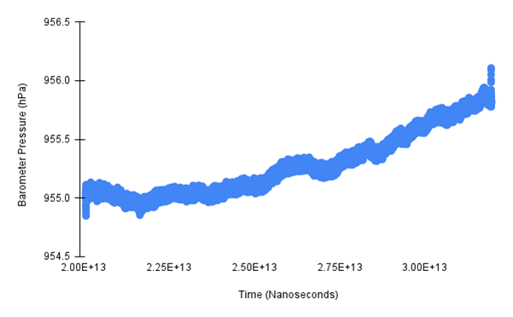
Ambient Pressure Experiment – Trial 4
Trial 4 Information:
Interval: 3 hours
Time: 5:30 pm - 8:30 pm

Slide 21
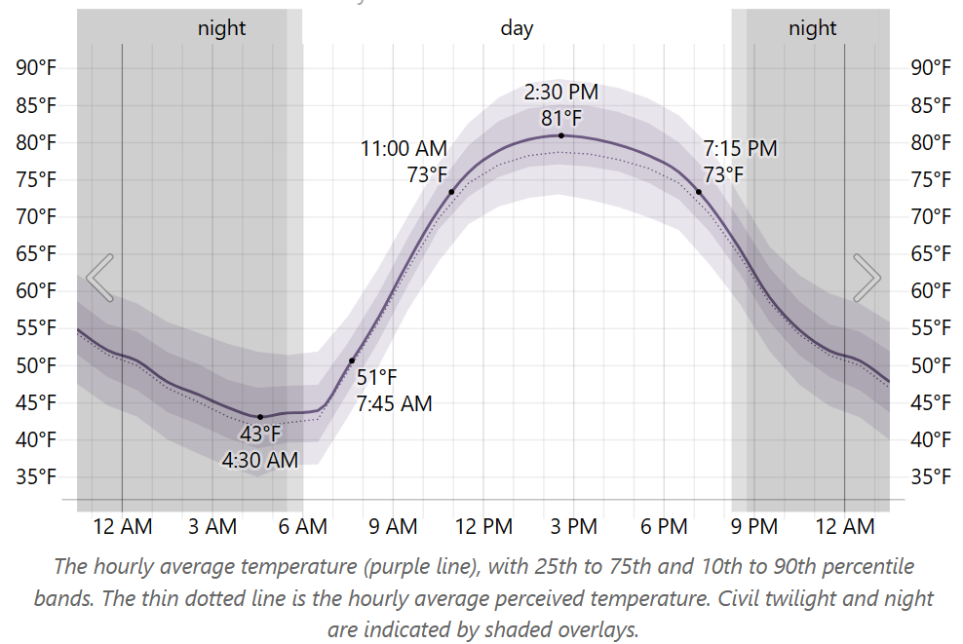
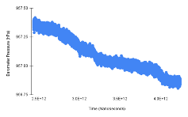
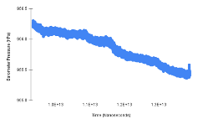

Ambient Pressure Experiment – Takeaways
Takeaways
As the temperature rose throughout the day the ambient pressure within the closed-off room fell. As the air near the ground heats up it rises into the atmosphere and causes the pressure near the ground to drop.
As the temperature fell in the evening the ambient pressure within the closed-off room rose. As the air in the atmosphere cools down it falls towards the ground, causing the pressure near the ground to rise.
Any practical application of a barometer sensor must account for the ambient pressure constantly fluctuating due to temperature and weather changes.

Slide 22
Breathalyzer Experiment
Hypothesis
A smartphone’s built-in barometer sensor is sensitive enough to detect when a user blows air over the device with their lungs.
Procedure
Subject holds the phone approximately four inches in front of their face.
Subject blows on the device in a specified area with as much force as possible while recordings are taken.
This process is repeated for four specified areas of the device.

Slide 23
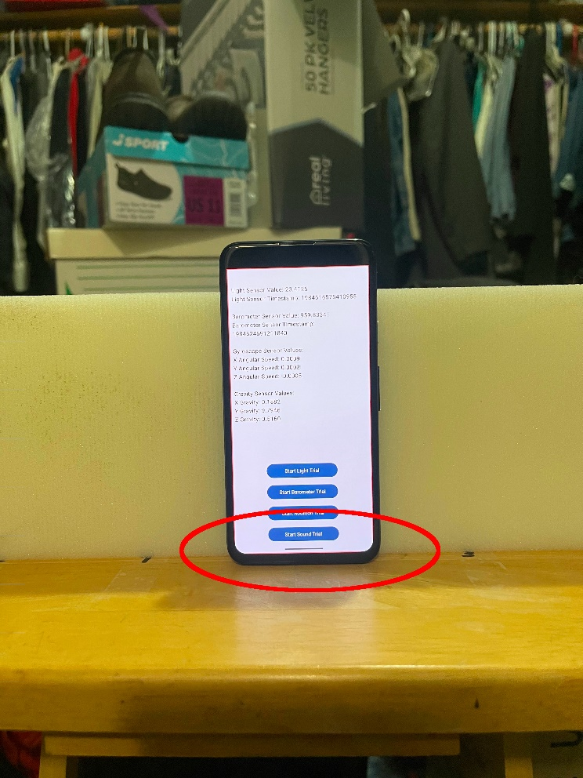
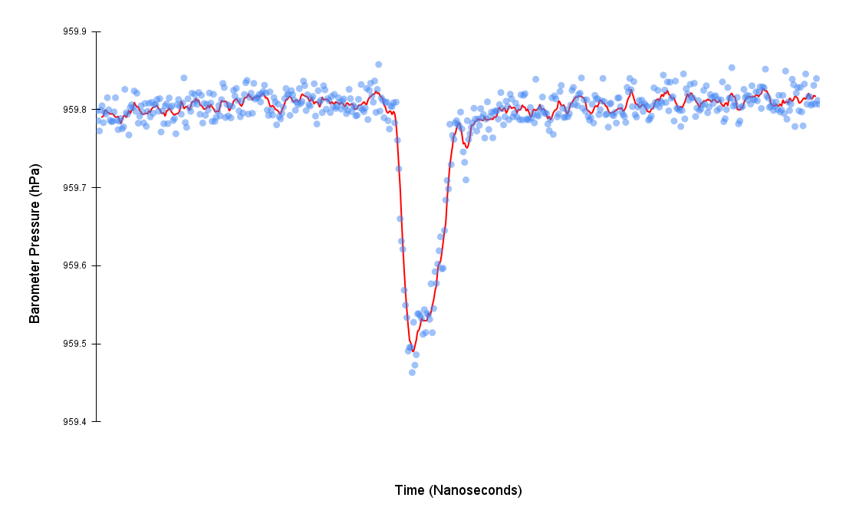
Breathalyzer Experiment – Bottom of the Front Face
Blow Location
Results

Slide 24
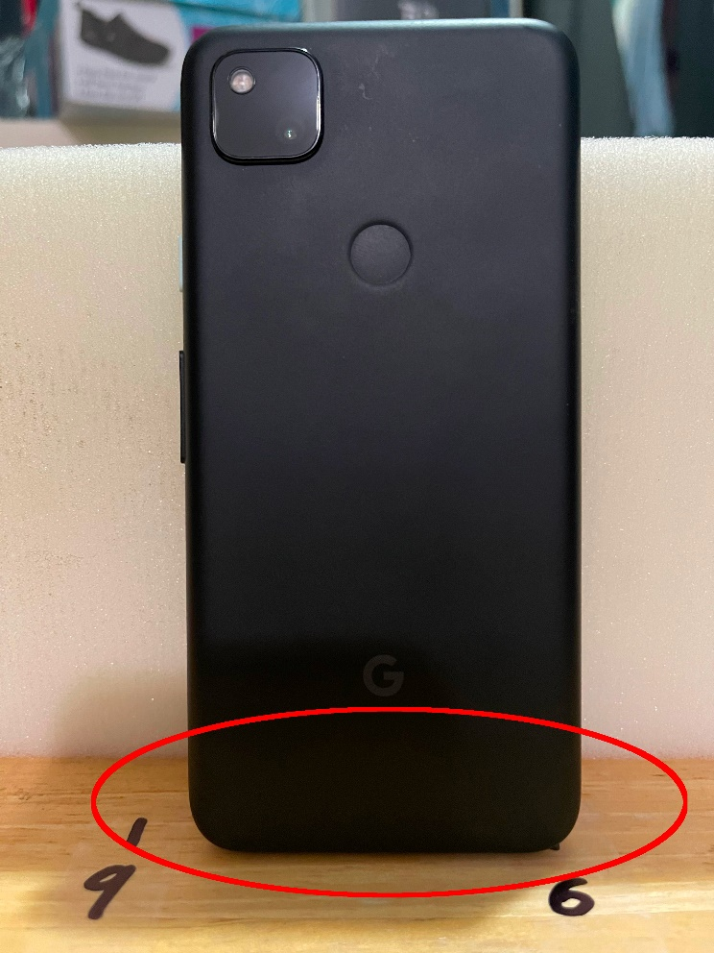
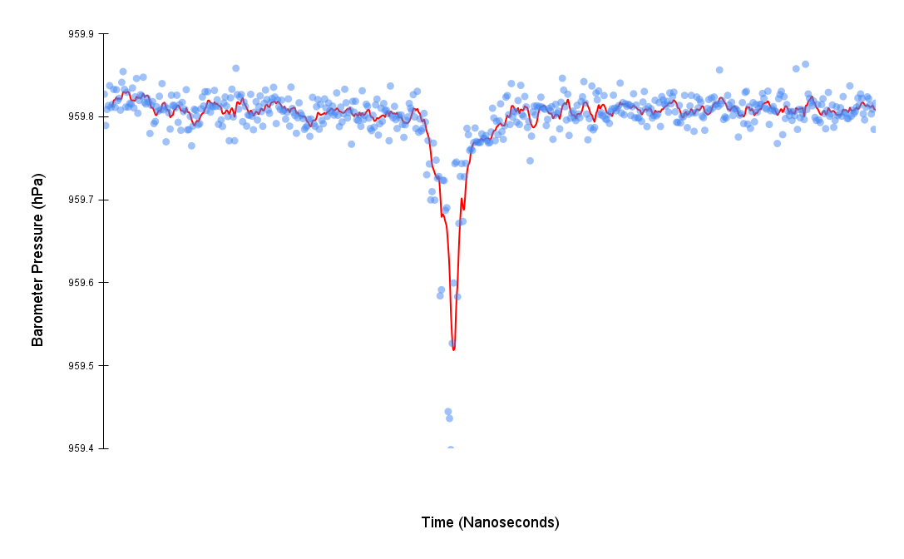
Breathalyzer Experiment – – Bottom of the Back Face
Blow Location
Results

Slide 25
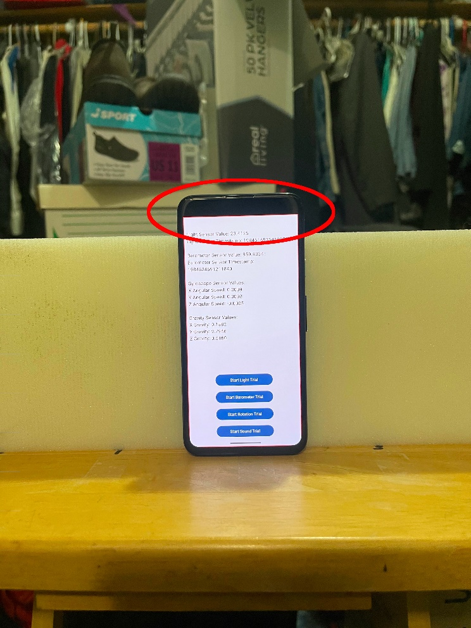
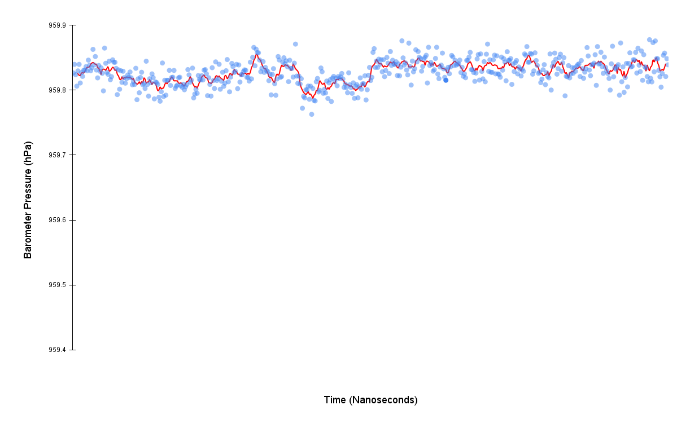
Breathalyzer Experiment – Top of the Front Face
Blow Location
Results

Slide 26
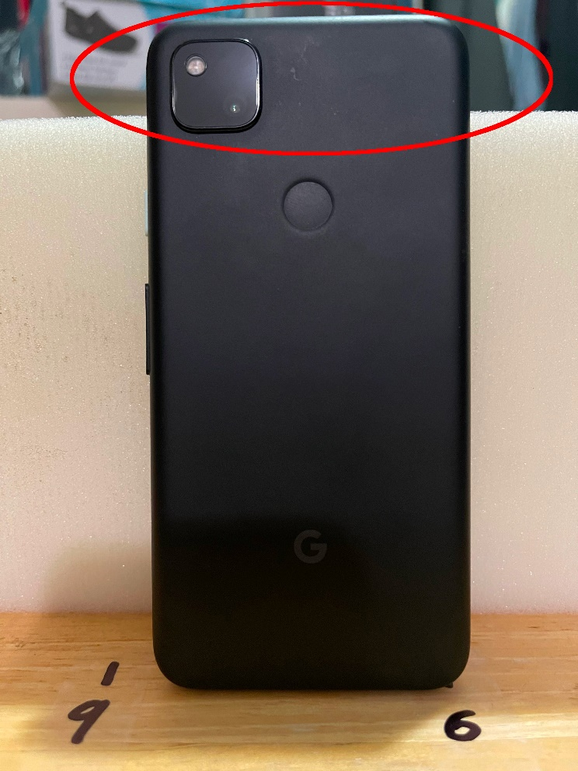
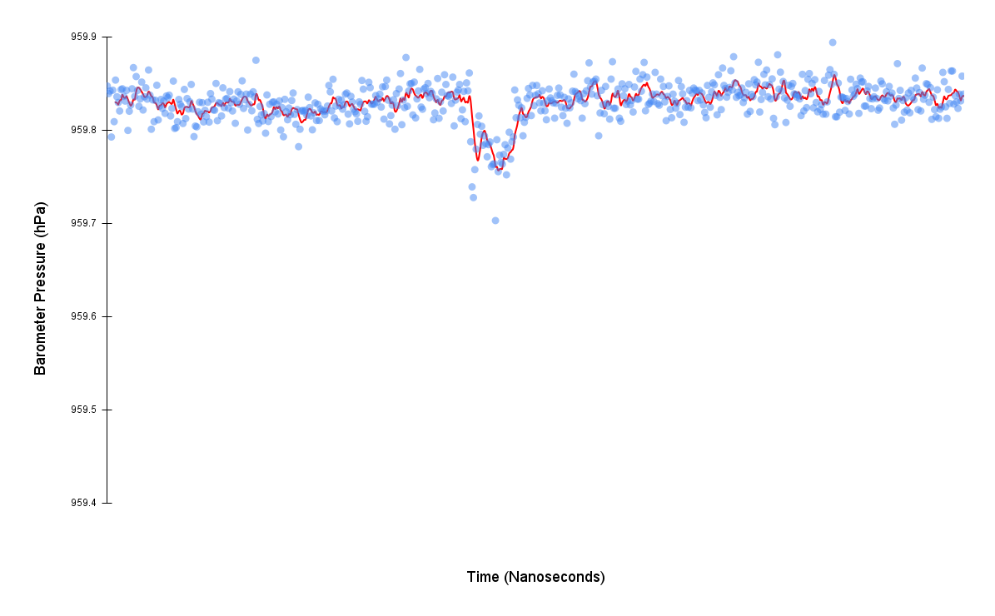
Breathalyzer Experiment – Top of the Back Face
Blow Location
Results

Slide 27
Breathalyzer Experiment – Takeaways
Takeaways
The barometer sensor can detect the subject’s blows at all the specified locations.
The most significant results were produced when the subject was instructed to blow towards the bottom of the device, suggesting the barometer within the Google Pixel 4a is located in that area.
The pressure values dropped when the subject blew over the device instead of increasing like initially expected. This is likely due to the venturi effect causing the pressure near the barometer sensor to drop.

Slide 28
Barometer Interface Application

Slide 29
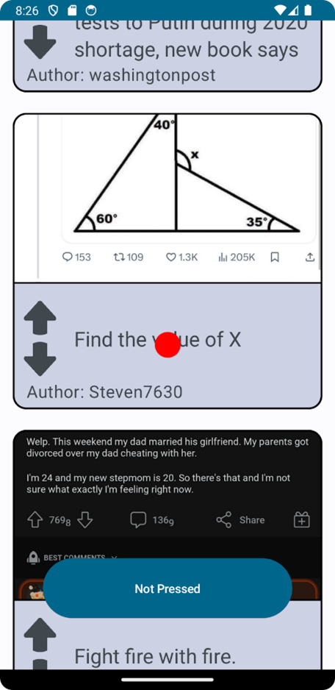
Barometer Interface Application
The experimental results demonstrate that the most practical approach to support mobile interaction using the barometer is to use it as a button-style input device. Treating a single blow as a simulated button press allows users to interact with mobile devices using just the pressure built up in their lungs.
To test the practicality of this approach an Android application was written to simulate the front page of the website Reddit.com. The app uses Reddit.com’s API to request the first 100 posts and displays them in a scrollable list.
In a fixed position in the center of the screen, there is a red cursor that is used to determine the post with which to interact. The app includes a button at the bottom of the screen for testing purposes, which can be used to simulate blowing on the barometer.
Notes:
Each post consists of a title, an upvote button, a downvote button, and an image if one is included in the post.

Slide 30
Blowing Language
A blowing language was created for input. The blowing language consists of four distinct on-screen actions, using one to four blows in a sequence. The on-screen actions map to the blowing actions in the following way:
One long continuous blow scrolls the screen for the duration of the blow.
Two blows within 500 ms of each other switches the direction the screen scrolls. By combining these first two input options the user can scroll up and down on the screen with just blowing.
Three blows, with each blow being within 500 ms of the previous blow, toggles the upvote button of the post underneath the red cursor. If the upvote button is unselected and grayed out, three blows will select it, turning it red. If the upvote button is red, three blows will deselect it, turning it gray. Regardless of the state of the upvote button, if the downvote button is blue, three blows will deselect it turning it gray.
Four blows, with each blow being within 500 ms of the previous blow, toggles the downvote button of the post underneath the red cursor. If the downvote button is unselected and grayed out, four blows will select it, turning it blue. If the downvote button is blue, four blows will deselect it, turning it gray. Regardless of the state of the downvote button, if the upvote button is red, four blows will deselect it turning it gray.

Slide 31
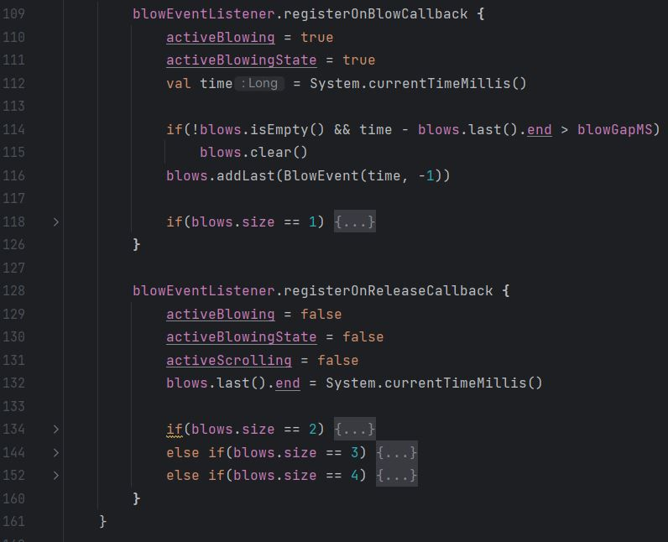
Blowing Language Implementation
MainActivity
onBlowCallback
onReleaseCallback
BlowEventListener
registerOnBlowCallback
registerOnReleaseCallback
Notes:
Looking at a snippet from the MainActivity class.
MainActivity provides the core logic for the blowing language.
BlowEventListener detects when a user blows over the device and triggers all the callback registered to its two events, the OnBlow event which happens when a user begins to blow, and the OnRelease event which happens when a user finishes blowing.
The variable blows is an array containing instances of the BlowEvent data class. The BlowEvent data class serves as a pair containing the starting timestamp of the blow and the ending timestamp of the blow. When the blow is initially stored in the blows array during the OnBlowEvent callback the ending timestamp is not known, so a value of -1 is stored in its place. When the OnReleaseEvent callback is triggered the ending timestamp of the last recorded blow is updated from -1 to the current timestamp. The collapsed if statements provide the functionality of the blowing language. There is an if statement for each of the four possible blow interactions. One collapsed if statement is in the OnBlowCallback function and the other three collapsed if statements are in the OnReleaseCallback function. The reason one if statement is separated from the rest is that it implements the scrolling functionality, which takes place during the duration of a user’s blow, not after it like the three other interface interactions.

Slide 32
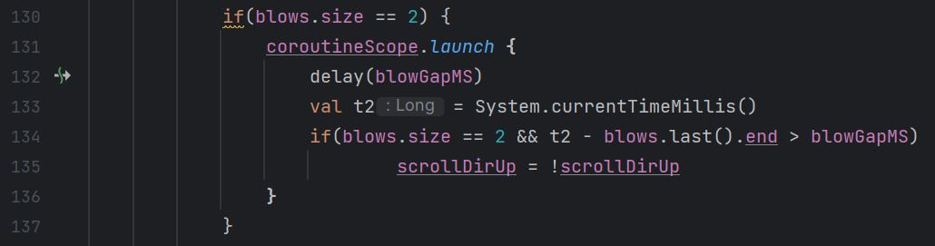
Blowing Language Implementation

Slide 33
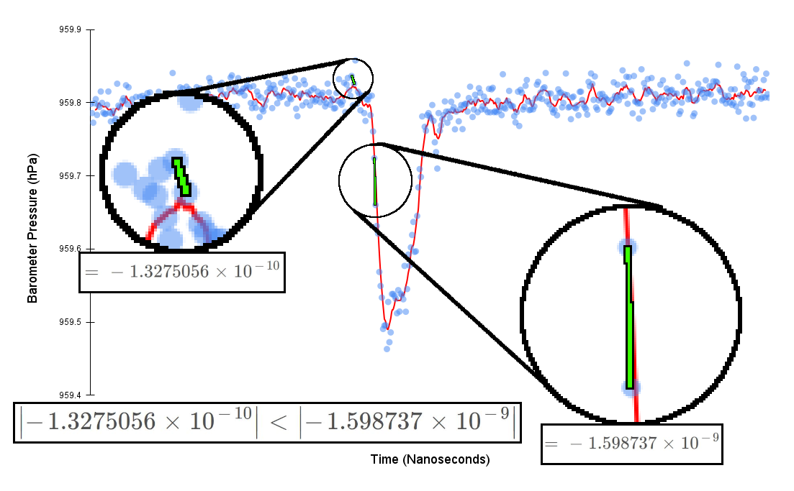
Detecting Blows Using a Slope Threshold
Methodology
Calculate slope between the data point last measured and the current data point.
If the absolute value of the slope is above the specified threshold, 1.5x10^-9, consider the current data point an outlier and part of a blow.
Three outlier data points within a 450 ms time window trigger a blow event.
Notes:
Pros: Don’t have to worry about pressure values fluctuating slowly due to temperature and weather.
Cons: When a user begins blowing and ends blowing a sharp slope can be expected, but during the middle section of a long duration blow the slope trends towards 0 if the user is blowing consistently. This causes long duration blows to sometimes be detected as multiple short blows.

Slide 34
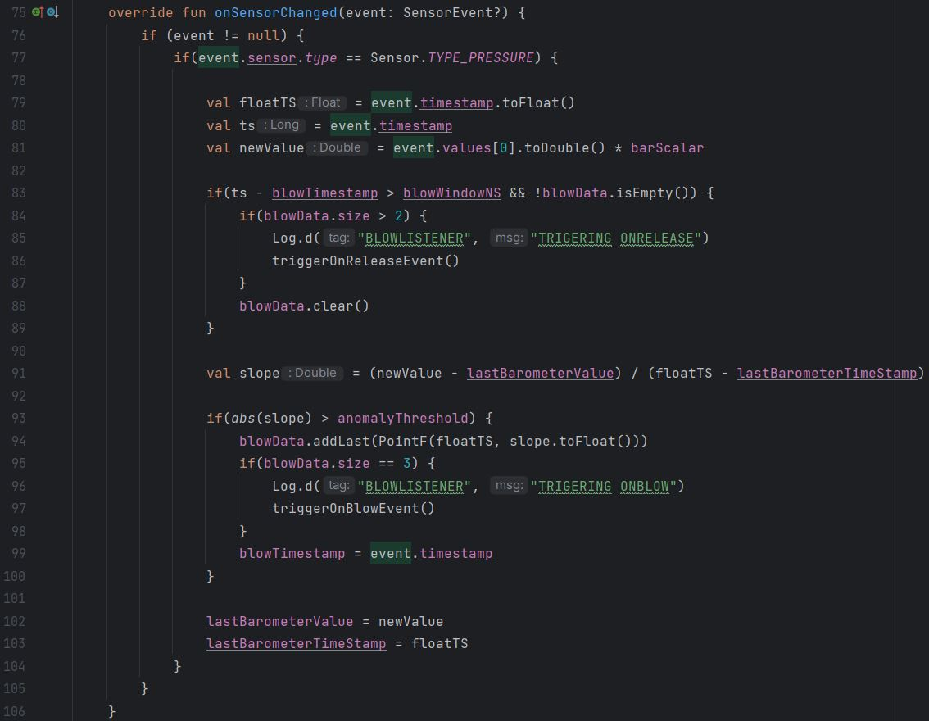
Slope Threshold Implementation
Lines 83 – 89 check if the last recorded blow data is out of date and deletes it if it is. If at least 3 data points were recorded the release event is triggered.
Line 91 calculates the slope.
Line 46 – 52 checks if the absolute value of the slope is greater than the anomaly threshold and records it if it is. If at least 3 data points have been recorded a blow even is triggered.

Slide 35
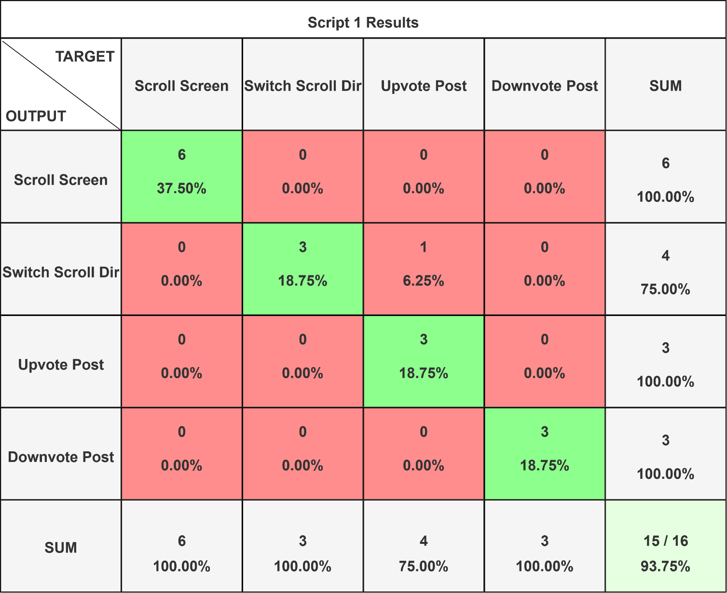
Slope Threshold Evaluation – Script 1 Results
Script 1
Scroll the screen down three posts.
Switch the scroll direction.
Scroll the screen up three posts.
Upvote the post under the cursor.
Downvote the post under the cursor.

Slide 36

Slope Threshold Evaluation – Script 2 Results
Script 2
Upvote the post under the cursor.
Scroll the screen down six posts.
Switch the scroll direction.
Upvote the post under the cursor.
Scroll the screen up three posts.
Downvote the post under the cursor.

Slide 37

Slope Threshold Evaluation – Script 3 Results
Script 3
Scroll the screen down two posts.
Downvote the post under the cursor.
Scroll the screen down two posts.
Switch the scroll direction.
Downvote the post under the cursor.
Scroll the screen up three posts.
Upvote the post under the cursor.
Switch the scroll direction.
Scroll the screen down one post.
Upvote the post under the cursor.

Slide 38
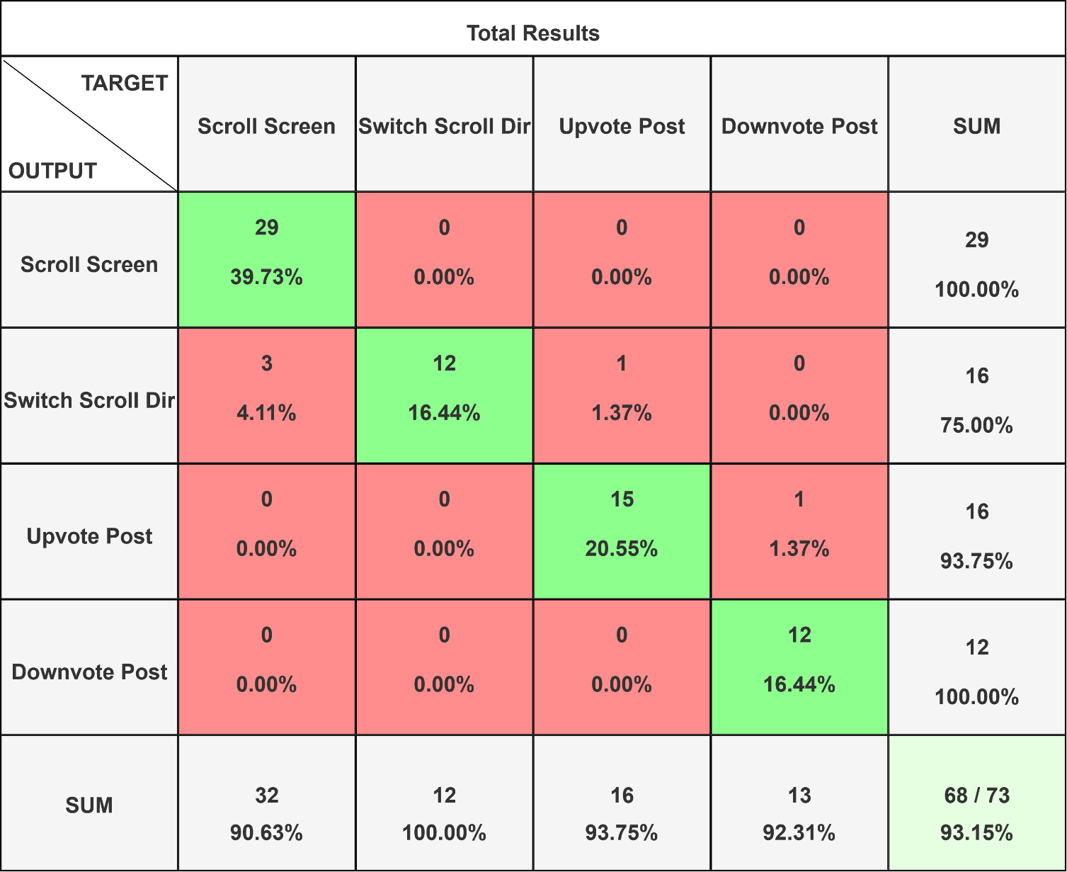
Slope Threshold Evaluation – Total Sum of All 3 Scripts
29 out of 32 Scroll Screen actions were correctly detected, giving an accuracy of 90.63%.
12 out of 12 Switch Scroll Direction actions were correctly detected, giving an accuracy of 100%.
15 out of 16 Upvote Post actions were correctly detected, giving an accuracy of 92.31%.
12 out of 13 Downvote Post actions were correctly detected, giving an accuracy of 92.31%
68 out of 73 actions were correctly detected, giving a total accuracy of 93.15%

Slide 39
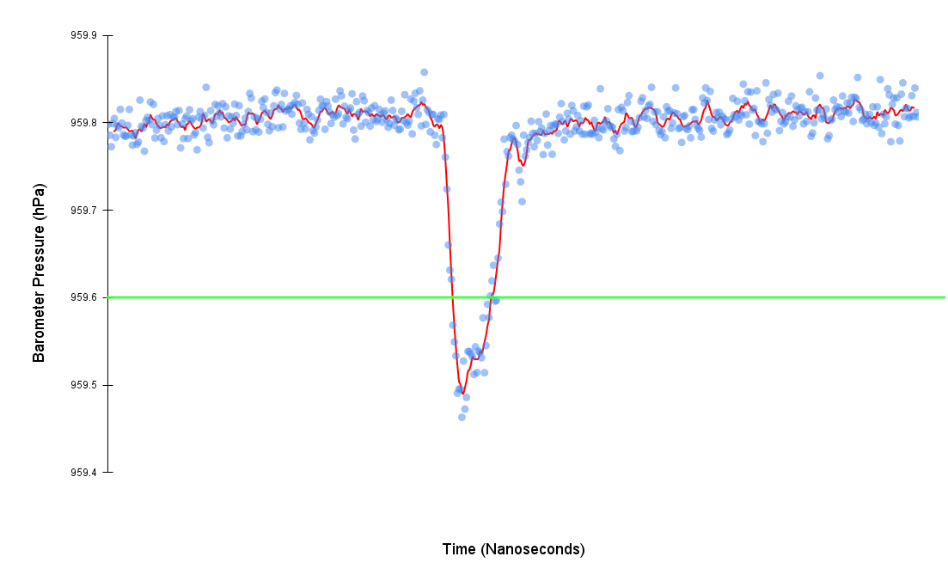
Detecting Blows Using a Pressure Threshold
Methodology
Use a threshold based on the current pressure value.
If the absolute value of the current pressure value is above the specified threshold consider the current data point an outlier and part of a blow.
Three outlier data points within a 450 ms time window trigger a blow event.

Slide 40
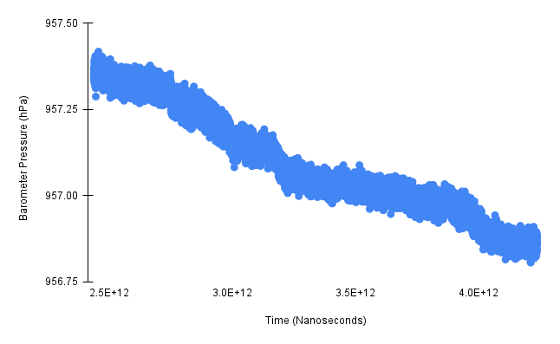
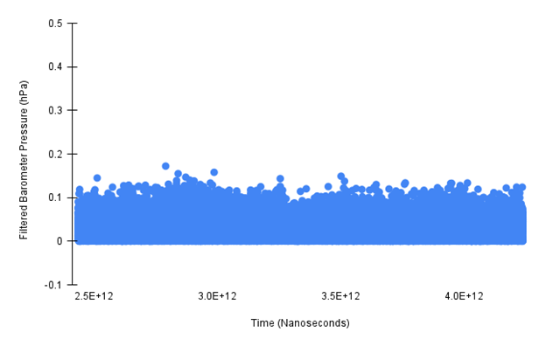
Pressure Threshold High-Pass Filter
Ambient Pressure Issue
As the ambient pressure changes throughout the day due to temperature and weather changes, a constant threshold value would become outdated and fail to properly detect outliers
High-Pass Filter Solution
A high-pass infinite-impulse response filter can use a cutoff frequency, 1/ (5 * 60) Hz in this case, to filter out low-frequency changes in the ambient pressure, allowing for the use of a constant threshold value of 0.20 hPa.

Slide 41
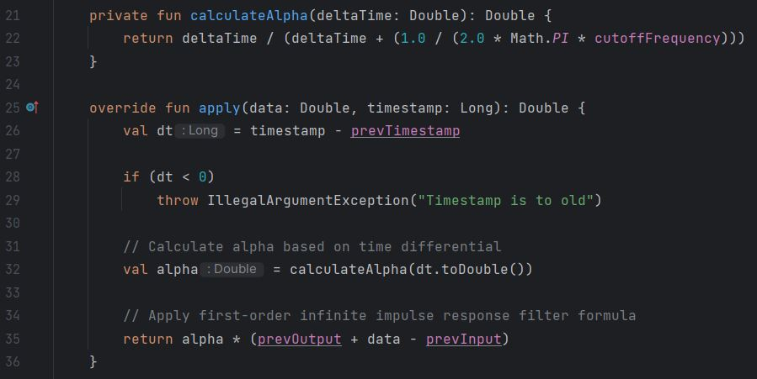
Pressure Threshold High-Pass Filter Implementation

Slide 42
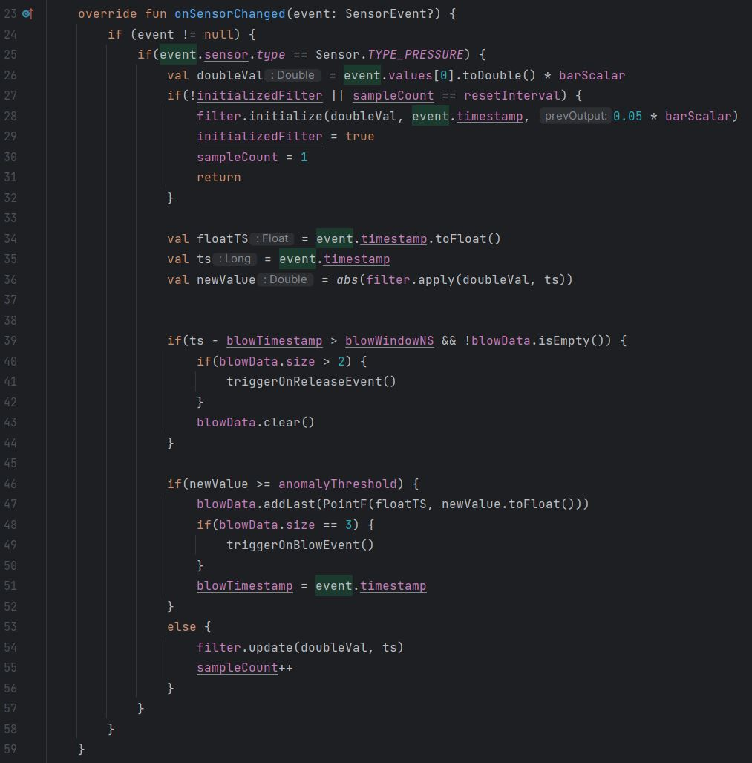
Pressure Threshold Implementation
Lines 25 – 31 initialize and reset the high-pass filter.
Line 36 applies the filter to the current data point.
Lines 39 – 44 check if the last recorded blow data is out of date and deletes it if it is. If at least 3 data points were recorded the release event is triggered.
Line 46 – 52 checks if the filtered data is greater than the anomaly threshold and records it if it is. If at least 3 data points have been recorded a blow even is triggered.
Line 54 updates the filter if the current data is not considered an anomaly/outlier.

Slide 43
Pressure Threshold Evaluation – Script 1 Results
Script 1
Scroll the screen down three posts.
Switch the scroll direction.
Scroll the screen up three posts.
Upvote the post under the cursor.
Downvote the post under the cursor.

Slide 44

Pressure Threshold Evaluation – Script 2 Results
Script 2
Upvote the post under the cursor.
Scroll the screen down six posts.
Switch the scroll direction.
Upvote the post under the cursor.
Scroll the screen up three posts.
Downvote the post under the cursor.

Slide 45

Pressure Threshold Evaluation – Script 3 Results
Script 3
Scroll the screen down two posts.
Downvote the post under the cursor.
Scroll the screen down two posts.
Switch the scroll direction.
Downvote the post under the cursor.
Scroll the screen up three posts.
Upvote the post under the cursor.
Switch the scroll direction.
Scroll the screen down one post.
Upvote the post under the cursor.

Slide 46

Pressure Threshold Evaluation – Total Sum of All 3 Scripts
27 out of 28 Scroll Screen actions were correctly detected, giving an accuracy of 96.43%.
12 out of 12 Switch Scroll Direction actions were correctly detected, giving an accuracy of 100%.
15 out of 16 Upvote Post actions were correctly detected, giving an accuracy of 92.31%.
12 out of 13 Downvote Post actions were correctly detected, giving an accuracy of 92.31%
66 out of 69 actions were correctly detected, giving a total accuracy of 95.65%

Slide 47
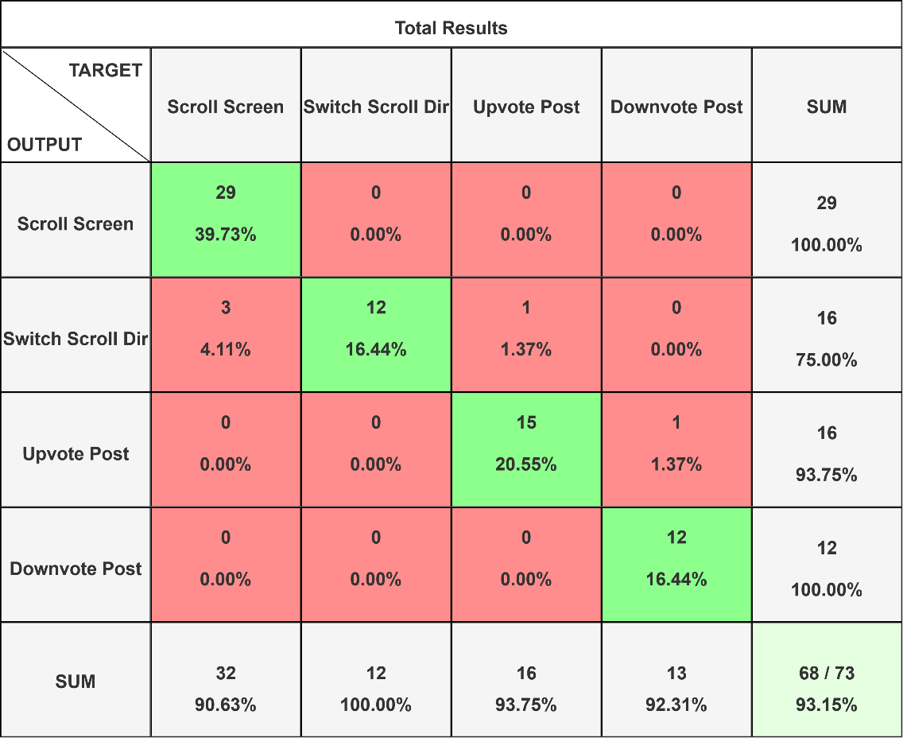

Slope Threshold vs Pressure Threshold
Slope Threshold Total Results
Pressure Threshold Total Results
The Pressure Threshold implementation is 2.5% more accurate and can detect the Screen Scrolling action 5.8% better than the Slope Threshold implementation.

Slide 48
Demonstration

Slide 49
Conclusion
Sensors within modern smartphones represent a large untapped potential of novel applications. Research has already shown that just the barometer sensor can be used in unique and unsuspecting ways.
To explore novel applications of the barometer sensor multiple experiments were conducted. The results of which showed that a smartphone’s barometer sensor is not sensitive enough to detect loud nearby sounds but is sensitive to temperature and weather changes and can detect when a user blows air over it.
An application that mimics the website Reddit.com was developed to test the feasibility of using the barometer as a user input device by detecting when a user blows air over the device.
Two pressure outlier detection methods, a slope threshold method and a filtered pressure threshold method, were implemented and tested.
The filtered pressure threshold method outperformed the slope threshold method by 2.5% and was 5.8% better at detecting long-duration blows. Out of 69 actions taken by the user, the filtered pressure threshold method accurately detected 66 of them, with an accuracy of 95%
Using a barometer as a user input device by detecting when a user blows over a smartphone proves to be a novel practical use case for a smartphone’s barometer sensor.

Slide 50
References
Balz Maag, Zimu Zhou, Olga Saukh, and Lothar Thiele. 2017. Barton: Low power tongue movement sensing with In-Ear Barometers. 2017 IEEE 23rd International Conference on Parallel and Distributed Systems (ICPADS) (December 2017). DOI:http://dx.doi.org/10.1109/icpads.2017.00013
Diansheng Chen, Yu Zhang, Wei Feng, and Xiyu Li. 2018. A wireless real-time fall detecting system based on barometer and Accelerometer. 2012 7th IEEE Conference on Industrial Electronics and Applications (ICIEA) (July 2012). DOI:http://dx.doi.org/10.1109/iciea.2012.6361022
Haibo Ye, Li Sheng, Tao Gu, and Zhiqiu Huang. 2019. SELoc: Collect your location data using only a barometer sensor. IEEE Access 7 (June 2019), 88705–88717. DOI:http://dx.doi.org/10.1109/access.2019.2925460
Haibo Ye, Tao Gu, Xianping Tao, and Jian Lu. 2016. Scalable floor localization using barometer on smartphone. Wirel. Commun. Mob. Comput. 16, 16 (November 2016), 2557–2571. DOI:https://doi.org/10.1002/wcm.2706
Hiroaki Nakanishi, Sayaka Kanata, and Tetsuo Sawaragi. 2011. Measurement model of barometer in ground effect of unmanned helicopter and its application to estimate terrain clearance. 2011 IEEE International Symposium on Safety, Security, and Rescue Robotics (November 2011). DOI:http://dx.doi.org/10.1109/ssrr.2011.6106764
Lili Xie, Jun Tian, Genming Ding, and Qian Zhao. 2018. Human activity recognition method based on inertial sensor and Barometer. 2018 IEEE International Symposium on Inertial Sensors and Systems (INERTIAL) (March 2018). DOI:http://dx.doi.org/10.1109/isiss.2018.8358140
Muchen Wu, Parth H. Pathak, and Prasant Mohapatra. 2015. Monitoring building door events using barometer sensor in smartphones. In Proceedings of the 2015 ACM International Joint Conference on Pervasive and Ubiquitous Computing (UbiComp '15). Association for Computing Machinery, New York, NY, USA, 319–323. https://doi.org/10.1145/2750858.2804257
Muyan Yao, Dan Tao, Ruipeng Gao, Jiangtao Wang, Sumi Helal, and Shiwen Mao. 2022. PresSafe: Barometer-based on-screen pressure-assisted implicit authentication for smartphones. IEEE Internet of Things Journal 10, 1 (August 2022), 285–302. DOI:http://dx.doi.org/10.1109/jiot.2022.3199657
Nozhan Ghoreishi, Femi Olugbon, John LaCourse, Sajay Arthanat, Dain LaRoche, and Diliang Chen. 2023. The potential of wrist-worn barometer for measuring load vertical location in manual material lifting tasks: A pilot study. 2023 IEEE Biomedical Circuits and Systems Conference (BioCAS) (October 2023). DOI:http://dx.doi.org/10.1109/biocas58349.2023.10388547
Olivia Sidoti, Risa Gelles-Watnick, Michelle Faverio, Sara Atske, Kaitlyn Radde, and Eugenie Park. 2024. Mobile Fact Sheet. (January 2024). Retrieved October 14, 2024 from https://www.pewresearch.org/internet/fact-sheet/mobile/#mobile-phone-ownership-over-time
Ping-Fan Ho, Chia-Che Hsu, Jyh-Cheng Chen, and Tao Zhang. 2018. Using Barometer on Smartphones to Improve GPS Navigation Altitude Accuracy. In Proceedings of the 24th Annual International Conference on Mobile Computing and Networking (MobiCom '18). Association for Computing Machinery, New York, NY, USA, 741–743. https://doi.org/10.1145/3241539.3267735
Satoshi Hyuga, Masaki Ito, Masayuki Iwai, and Kaoru Sezaki. 2015. Estimate a user's location using smartphone's barometer on a subway. In Proceedings of the 5th International Workshop on Mobile Entity Localization and Tracking in GPS-less Environments (MELT '15). Association for Computing Machinery, New York, NY, USA, Article 2, 1–4. https://doi.org/10.1145/2830571.2830576
Satoshi Hyuga, Masaki Ito, Masayuki Iwai, and Kaoru Sezaki. 2015. Estimate a user's location using smartphone's barometer on a subway. In Proceedings of the 5th International Workshop on Mobile Entity Localization and Tracking in GPS-less Environments (MELT '15). Association for Computing Machinery, New York, NY, USA, Article 2, 1–4. https://doi.org/10.1145/2830571.2830576

